Slide 1
Week 7 DNA sequence alignment and BioPython

Slide 2
DNA sequence alignment

Slide 3
Homologous DNA sequences can be different by point mutations and insertions/deletions
A Point mutation causes a difference in the base at a particular position
TAGCTGACTA
TAGCTGGCTA
An insertion or deletion causes a change in the length
TAGCTGACTA
TAGCGCGCGCTGACTA
When comparing two homologous DNAs of different lengths, you don’t know whether there has been an insertion in one or a deletion in the other
Insertions/deletions are often called ‘indels’ for this reason

Slide 4
The need for DNA alignment
Two homologous DNAs cannot be compared and studied together unless we know which bases in one are directly homologous from which bases in the other.
If homologous DNAs are correctly aligned, then we know that the differences between them have been caused by mutations
All evolutionary studies using DNA sequences begin with DNA alignment

Slide 5
DNA sequence alignment
Three Situations where Alignment is Needed
finding homologous sequences in databases
BLAST Altschul, S. F., W. Gish, W. Miller, E. W. Myers, and D. J. Lipman. 1990. Basic local alignment search tool. J. Mol. Biol. 215:403-410.
Compare two sequences, find the longest stretch of identity - the maximal segment pair (MSP). Assess the probability of such a stretch.
aligning homologous sequences by including gaps
given two or more sequences that you know, or have decided, are homologous
line them up so that homologous base pairs are identified
Requires adding insertions and deletions (called indels)
genome assembly
Aligning short-read data to a reference genome
de-novo genome assembly (much harder)

Slide 6
Examples for 2 short sequences
1:tgt
2:tctt
Some of the many possible alignments
1:tg-t
2:tctt
1:t-gt
2:tctt
1:t-gt-
2:tc-tt
1:tgt----
2:---tctt

Slide 7
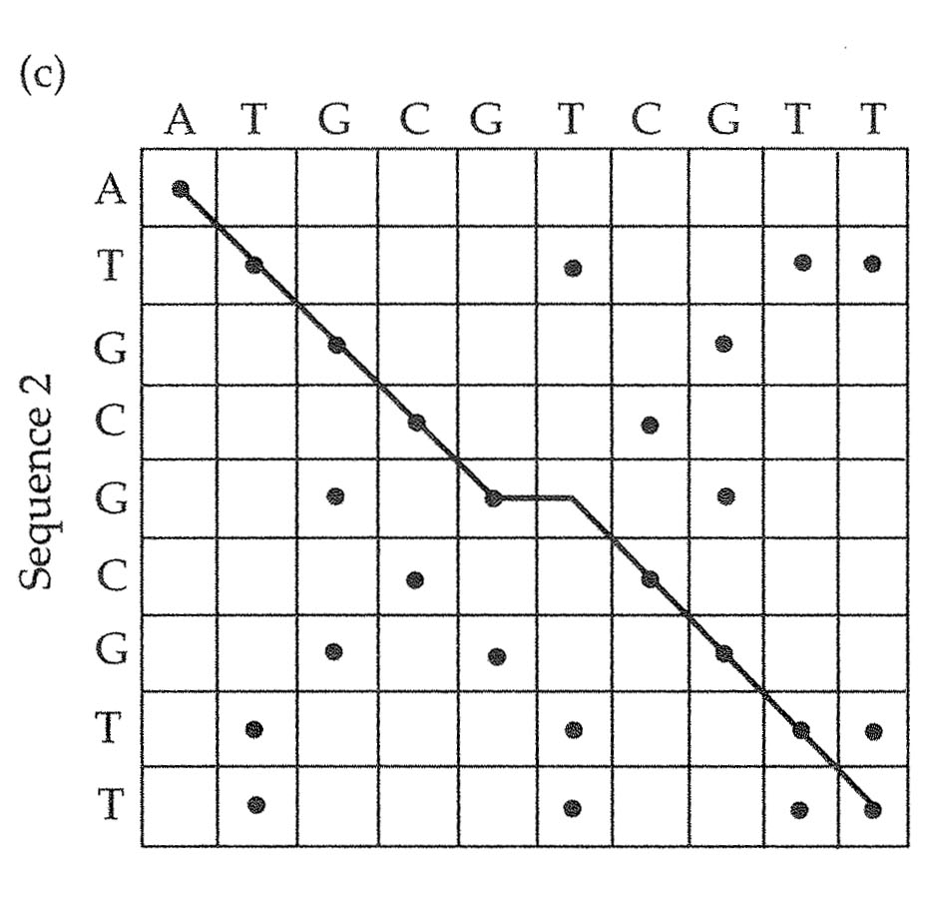
DNA sequence alignment by hand, using Dot Plots
Alignment using Dot Matrix Comparison
Sequence 1 ATGCGTCGTT
Sequence 2 ATGCGCGTT
After Dot-matrix comparison
Sequence 1 ATGCGTCGTT
Sequence 2 ATGCG-CGTT

Slide 8
DNA sequence alignment
Alignment is an optimization problem.
You can always align any two sequences if you are willing to be liberal with indels.
In general there are three quantities that you want to optimize
The fewest possible base mismatches
the fewest possible indels
the shortest possible indels

Slide 9
DNA sequence alignment by Optimization Algorithm
Optimization Algorithms:
Give a score to every possible alignment
Requires preset penalties for
Every mismatch
every indel
indel length extensions
Pick the alignment that has the best score
For pairwise alignment, the Needleman-Wunsch algorithm can identify the optimal alignment, given mismatch and indel penalties

Slide 10
Optimization Algorithms
It is difficult to know what penalty values to assign
Alignment of closely related sequences that do not have a lot of repeats within them is easily done by eye.
Alignment of distantly related sequences can be very difficult
In general very little good biological theory for alignment – though lots of neat math.
Evolutionary biologists often do not use regions that are difficult to align.

Slide 11
Multiple DNA Sequence Alignment
Especially difficult because some sequences are more closely related to others.
Need to estimate evolutionary tree at the same time as estimating the multiple alignment.
If sequences have had a history of recombination (different trees for different parts of the sequence), no good way to do it.

Slide 12
Consensus sequences
A consensus sequence is a DNA sequence made from two or more aligned sequences
ACTAATGATA
TGATACCTTGCTA
TAC-TT---ATCT
ATGATA--------TCTAAATC
ACTAATGATACCTTGCTATCTAAATC

Slide 13
Consensus sequences
For base positions that match perfectly across the aligned sequences, the base value in the consensus is the same as in the aligned sequences
But what should be in the concensus when the aligned sequences do not match perfectly?

Slide 14
Consensus sequences with mismatches
Strict Consensus
At any base position where the aligned sequences are not all identical, the consensus sequence has an ‘N’
Use IUPAC ambiguity codes
At a base position where there are multiple bases the consensus sequence has the IUPAC ambiguity code for all those bases. E.g. K, Y etc
Use some kind of percentage based system.
For example, if one base occurs in more than 50% of the aligned sequences, put that base in the consensus, otherwise put an ‘N’

Slide 16
Biopython
http://biopython.org/DIST/docs/tutorial/Tutorial.html
Bio is the name of a package which contains a bunch of packages of modules
In IDLE or at a python prompt:
Type: import Bio
Type: help(Bio)
At the center of BioPython are classes for handling of DNA and Protein sequences

Slide 17
Object Oriented Languages and Classes
Python is an object-oriented programming language
can think of everything (variables, functions, packages, modules, numbers, other types of data) as objects
objects can have attributes
object-oriented languages, including python, have ‘classes’.
In python you can have user-defined classes that are similar to what python calls a ‘type’ (e.g. remember using the following types: string, int, float, list etc) except that it is defined by the user.
Classes and types can have two main categories of attributes: data and methods (also known as functions). The data can include instances of basic python types or other classes.
When you specify a new variable that belongs to a certain class, you are creating an object that is an instance of that class:

Slide 18
The Seq class
Type: from Bio.Seq import Seq
This imports the Seq class
Type dir(Seq)
Type help(Seq)
Objects of the Seq class contain two kinds of data:
a sequence string
an object of a class called ‘alphabet’
Creating an instance of the Seq class:
Type: myseq = Seq("ATGTTCGTA")
Type: myseq

Slide 19
Dealing with Alphabets
Currently myseq does not have a specified alphabet.
Type: myseq.alphabet
Any parts of biopython that require a particular alphabet won’t know what to do with it.
However many methods can figure out what the alphabet should be, so often we don’t have to worry about the alphabet very much.
Look at the methods that belong to Seq objects:
Type dir(myseq)
Type myseq.reverse_complement()
Type myseq.translate()
Type myseq.transcribe()

Slide 20
The SeqRecord class
Import the class SeqRecord
Type: from Bio.SeqRecord import SeqRecord
SeqRecord is a class that includes the class Seq
Type: help(SeqRecord)
You will see the main attributes (data) and methods associated with this class
The main attributes are an instance of a Seq class, and several strings that can provide information about the sequence, including ‘id’, ‘name’, ‘description’, etc
Type:
myseqrecord=SeqRecord(seq=myseq,id=”testing seqrecord class”)
Type: myseqrecord

Slide 21
Confusion alert!
It is easy to confuse a Seq with a SeqRecord
The data in a Seq includes a string (e.g. a DNA sequence) and maybe also an alphabet designation.
A SeqRecord also has other data types. One of the data types of a SeqRecord is named seq (note the lower case!) and this piece of data is a Seq.
Do not confuse a python class with a file format:
In BioPython, a Seq and a SeqRecord do not have formats. These things can hold a sequence, but they themselves do not correspond to specific file formats. They can be used with the SeqIO module to read and write files of specific file formats.

Slide 22
DNA sequence files and parsing
A common programming job is to read a DNA sequence, from a computer file.
DNA sequences in computer files come in specific formats (e.g. Genbank format and Fasta format)
Parsing : the process of interpreting a series of symbols (i.e. a text of some sort) and putting it into another format that is more suitable for some purpose.
Because DNA, RNA and Protein sequences in computer files come in many different formats. We often need to be able to get data from files in different formats, or to read data from a file in one format and to output it in another format.

Slide 23
Fasta and Genbank formats
Fasta Format for Sequences
Open the file Dromel_Adh.
This file is in a format called Fasta.
Fasta is very simple, with very few strong rules ;
The first line begins with a ‘>’ and is followed by descriptive text
All of the following lines, up to an empty line, contain the sequence
Can have multiple sequences, when a line begins with ‘>’ is is the description line for the next sequence
Fasta format is very useful for providing a sequence in a small amount of space. It is very easy to write a program to read a fasta sequence file.
Fasta format is not very useful for providing much information about sequences.
Genbank Format
Genbank is a widely used format for DNA (and other types) of sequences. It is not as simple or as easy to use as Fasta, but it is great for containing annotation information about sequences.
A Genbank file or a Fasta file may have one or multiple formatted sequences (but a file should not have both types).
It is common for files containing fasta format sequences to have an extension ‘fa’ or ‘fas’ or ‘fasta’. Genbank files usually have the extension ‘gb’.

Slide 24
Downloading a sequence in Genbank format
In your internet browser go to the nucleotide database of NCBI
https://www.ncbi.nlm.nih.gov/nuccore/
In the search window type and enter: NM_000518
Click on ‘Send to’
Select 'File'
Under 'Format' select ‘GenBank’
Click on ‘Create File’
Save the file. (it will be called something like ‘sequences.gb’)
If the browser lets you choose the location put it in your working directory on your scratch drive
Otherwise after saving, move the file to this week’s working directory on your scratch drive
Rename the file to ‘NM_000518.gb’
Open the file in some viewer or editor and take a look at it.

Slide 25
Using SeqIO to parse a genbank format sequences
SeqIO is named for Input and Output of sequences
See Chapters 2 & 5 in the BioPython tutorial :
http://biopython.org/DIST/docs/tutorial/Tutorial.html
Type: from Bio import SeqIO
Type: help(SeqIO)
We will open the NM_000518.gb file using the file() function which is built into python.
Type and enter: gbfile = open("NM_000518.gb",”r”)
Now we will create an iterator and goes through the contents of gbfile record by record (however there is only one record). Use help(SeqIO.parse) to understand more about this.
Type and enter: gbrec_iter = SeqIO.parse(gbfile,"genbank")
Now we iterate by calling the iterator with its next() function
Type and enter: myseqrec = next(gbrec_iter)
Type and enter: gbfile.close()
Type and enter myseqrec and look at what you have.
Look at just the sequence string
Type: myseqrec.seq
Try taking just a slice of the sequence
Type: myseqrec.seq[100:200]

Slide 26
Using the entrez tools to access data from NCBI
The National Center for Biotechnology Information (NCBI) is part of the United States National Library of Medicine (NLM), a branch of the National Institutes of Health (NIH).
Entrez is NCBI’s primary text search and retrieval system
Check out Chapter 9 of the BioPython Cookbook
Review example programs:
Hey_J_biopython_Entrez_efetch_example1.py
Hey_J_biopython_Entrez_efetch_example2.py
Hey_J_biopython_Entrez_efetch_example3.py

Slide 27
Using Biopython to align sequences and build phylogenetic trees
There are many programs for doing DNA sequence alignment and for building phylogenetic trees
Suppose you want to automate the process ?
e.g. you have many data sets that you need to process
BioPython has some components that allow you to write a script that calls other programs, and then to do work on the results those programs return
Python is good for writing programs that run other programs (see the subprocess module)

Slide 28
biopython_alignment_and_phylogeny_example.py
Clustalw
http://www.clustal.org/clustal2/
http://biopython.org/DIST/docs/tutorial/Tutorial.html#htoc81
PhyML
http://www.atgc-montpellier.fr/phyml/
http://biopython.org/DIST/docs/tutorial/Tutorial.html#htoc217

